Slide 1
UEN002 – Energy and Environment
In the previous session, we went through…..
……the functional elements of MSW management,
  ……the scenario of MSW Management in India and abroad

Slide 2
Characterization of MSW
For Integrated waste management program
  Accurate and reliable data on waste composition and quantities is important
Data on quantity is important for
  Well organized and smooth management operations
  Optimal design and operation of recovery and incineration facilities
  Reducing the amount of waste generated

Slide 3
Characterization of MSW
Sampling protocols
  Direct sampling
  Material flows
  Surveys / secondary data collection
Variability affecting waste sampling
  Seasonal
  Regional
  Household

Slide 4
Chemical Properties of MSW
Ultimate analysis
Total elemental analysis
Used to characterize the chemical composition of the organic fraction of MSW
Involves determination of the percent values of Carbon, Hydrogen, Oxygen, Nitrogen, Sulfur and Ash in a sample
The oxygen value is calculated by subtracting other components including ash and moisture from 100%

Slide 5
Chemical Properties of MSW
Ultimate analysis
Component | % by Wt. (dry basis)
 | C | H | O | N | S | Ash
Organic
Paper | 43.5 | 6 | 44 | 0.3 | 0.2 | 6
Plastics | 60 | 7.2 | 22.8 | - | - | 10
Food | 48 | 6.4 | 37.6 | 2.6 | 0.4 | 5
Wood | 49.5 | 6 | 42.7 | 0.2 | 0.1 | 1.5
Inorganic
Glass | 0.5 | 0.1 | 0.4 | <0.1 | - | 98.9
Metals | 4.5 | 0.6 | 4.3 | <0.1 | - | 90.5
Mixed waste | 15-30 | 2-5 | 12-24 | 0.2-1.0 | 0.02-0.1 | ~40

Slide 6
Chemical Properties of MSW
2. Proximate Analysis
Estimates the capability of MSW as fuel
Includes following tests
  Moisture content, determined by loss of moisture after heating at 105⁰C for 1h.
  Volatile combustible matter, the additional loss of weight after ignition at 950⁰C for 7 min. in a covered crucible
  Fixed carbon, the combustible residue left after volatile matter is removed, ignition at 600-900⁰C
  Ash, the weight of residue after combustion in an open crucible

Slide 7
Chemical Properties of MSW
2. Proximate Analysis
Moisture and Ash represent the non-combustible component of MSW
Moisture/Ash are undesirable as they add to weight without adding heating value
Moisture adversely affects heat release from the fuel
Ash retains heat when removed from furnace resulting in loss in heat recovery

Slide 8
Chemical Properties of MSW
2. Proximate Analysis
Volatile matter and Fixed Carbon are preferred indicators of the combustion capability
Volatile matter is the portion converted into gas as temperature increases
Fixed carbon is solid carbon residue that remains in furnace grates
Combustion occurs on the surface of the ‘char’ material
Rate of combustion is affected by temperature and surface area of the char
% fixed carbon = 100% - % moisture - % ash - % volatiles

Slide 9
Chemical Properties of MSW
2. Proximate analysis
Component | % by Wt.
 | Moisture | Volatiles | Fixed carbon | Ash
Mixed food | 70 | 21 | 4 | 5
Mixed paper | 11 | 76 | 9 | 5
Mixed Plastics | 0.2 | 96 | 2 | 2
Mixed MSW | 10-40 | 30-60 | 3-15 | 10-30

Slide 10
Chemical Properties of MSW
3. Energy content in MSW
Can be determined by
  Combustion of samples in a full scale boiler and measuring steam output (or)
  Using bomb calorimeter (commonly used) – measures release of heat of combustion
  Determined using derivation
    U = C_{v} ΔT / M Where
    U is heat value (cal/g) of unknown material
    ΔT the rise of temperature in thermogram
    C_{v} the heat capacity (cal/ºC) of the calorimeter (standard)
    M Mass (g) of the unknown material

Slide 11
Chemical Properties of MSW
3. Energy content in MSW
The factors that must be considered when evaluating MSW as a potential fuel:
  Only dry organic matter yields energy
  Ash reduces the proportion of organic fuel per kg of MSW
  Ash retains heat when removed from furnace therefore results in heat loss
  Moisture reduces amount of organic fuel per kg of MSW and requires/utilizes significant amount of energy for evaporation
A well segregated and prepared MSW has typically 8950-13,400 kJ/kg of energy content

Slide 12
Chemical Properties of MSW
3. Energy content in MSW in approximations can also be determined
By Ultimate analysis (% wt) using
  Dulong Formula
  MJ/kg = 33.7C + 141.9 (H – O/8) +9.3S + 2.3 N (Where C, H, N, S and O are mass fractions)
Use Dulong Formula to estimate the heat value of Food waste with following composition:
48% Carbon, 6% Hydrogen, 38% Oxygen, 2.5% Nitrogen, 0.5% Sulphur and 5% ash. (All % by mass)
HV = 33.7 x 0.48 + 141.9 x (0.06 – (0.38/8)) + 9.3 x 0.005 + 2.3 x 0.025
= 18.05 MJ/kg

Slide 13
Chemical Properties of MSW
3. Energy content in MSW in approximations can also be determined
When the segregated composition is known
  Khan Formula
  E = 0.051 [F+3.6(CP)] 0.352 (PLR)
  Where E is energy content in MJ/kg
  F –weight of food waste
  CP- weight of cardboard + paper
  PLR – Plastic + Rubber
Calculate the heat value of the waste containing food (54%), paper (10%), and plastic (1.7%) for the city of Sofia.
= 17.58 MJ/kg

Slide 14
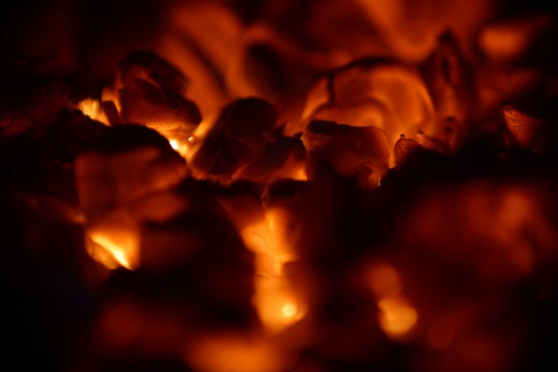
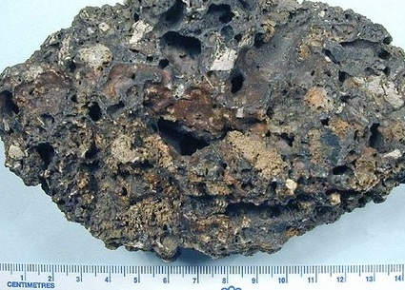
Chemical Properties of MSW
4. Fusing point of Ash
Physical behaviour of waste at higher temperature – softening and melting
Fusing point is the temperature at which ash from waste combustion from Clinker by fusion and agglomeration
Fusion point defines the scaling of ash on incinerator/boiler
Clinker formation for MSW normally range from 1100 to 1200⁰C

Slide 15
Chemical Properties of MSW
5. Content of nutrients and other substrates
Needed for use of MSW as a feedstock for composting or
Bioconversion into methane or ethanol
Composting and biogas formation is carried out by microbes
Nutrient content defines the potential of MSW to provide nutrition to microbes leading to degradation of waste
Significantly dependent on the organic fraction of the MSW
  Sugars / Starches
  Organic Acids
  Proteins and Amino Acids
  Hemicellulose / cellulose / lignocellulose
  Lignin
  Fats / oils / waxes

Slide 16
Chemical Properties of MSW
5. Content of nutrients and other substrates
Carbohydrates
  Main source in putrescible garbage and yard waste
  Sugars 4-6% and Starches 8-12% of dry weight of MSW
Crude Fibres
  Natural fibres such as cotton, wool, leather, cellulose, lignin, etc.
  Slowly biodegradable
  Cellulose accounts to 25-30% of dry weight of MSW and Lignin accounts to 10%
  Biodegradability of selected organic components in MSW
    Food waste – lignin content 0.4%
    Cardboard – lignin content 12.9%

Slide 17
Chemical Properties of MSW
5. Content of nutrients and other substrates
Lipids
  Fats, oils, Grease – 8-10% of MSW
  High energy value
  Slow biodegradability
Proteins
  Main source of N for the decomposition
  Generates odourous amines during decomposition
Biodegradability of MSW
  The biodegradability of organic fraction of MSW can be determined by tests for volatile solids and lignin content

Slide 18
Physical Properties of MSW
1. Density
Provides information for predicting storage volume
  As discarded
  As compacted during collection
  As compacted at land fill
The density of raw, un-compacted waste will vary as a function of
  composition,
  moisture content,
  physical shape, and
  degree of compaction
Density increases with increase in proportion of ceramics, ashes, metals, moisture

Slide 19
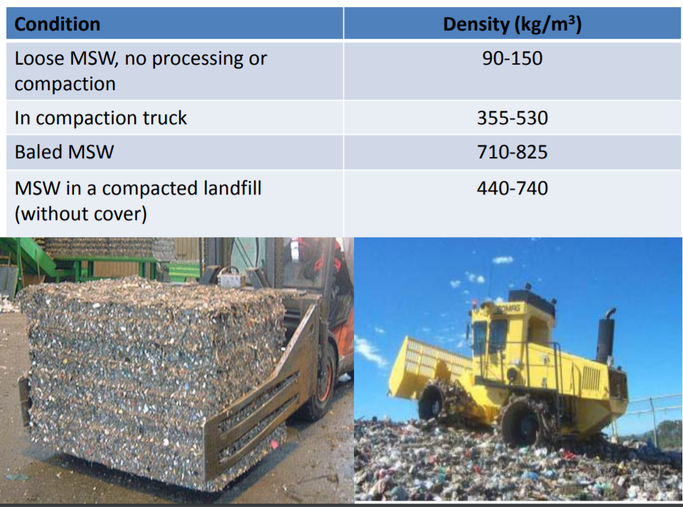
Physical Properties of MSW
1. Density
Raw wastes range in density from 90-150 kg/m³
Density of wastes at landfill range from 440-800 kg/m³
Volume reduction has significant impact on collection and hauling of MSW
Balers are major contributors in reducing the volume with increasing density

Slide 20
Physical Properties of MSW
1. Density
If materials having different densities are expressed in terms of their weight fraction, the calculation of overall bulk density is
  (M_{a} + M_{b}) / ([M_{a}/ρ_{a}] + [M_{b}/ρ_{b}])
  M – mass
  ρ - bulk density
The compaction ratio R is defined as the ratio of the as-compacted density ρ_{c} to the as-discarded density ρ_{d}
  i.e., R = ρ_{c} / ρ_{d}
For a particular community, assume that refuse has the following components and bulk densities: Component Percentage (by weight) (lb/ft³) Uncompacted bulk density
Miscellaneous paper 50 3.81
Garden waste 25 4.45
Glass 25 18.45
Assume that the compaction in the landfill is 1200 lb/yd³ (44.4 lb/ft³).
Estimate the percent volume reduction achieved during compaction of the waste. Estimate the overall uncompacted bulk density if the miscellaneous paper is removed.

Slide 21
Physical Properties of MSW
1. Density
Component | % by wt | Uncompacted Bulk Density (kg/m³)
Cardboard | 25 | 30
Paper products | 15 | 61
Aluminium | 9 | 38
Food and Yard waste | 51 | 375
Assume that the compaction in the landfill is 50 lb/ft³.
Estimate the percent volume reduction achieved during compaction of the waste.

Slide 22
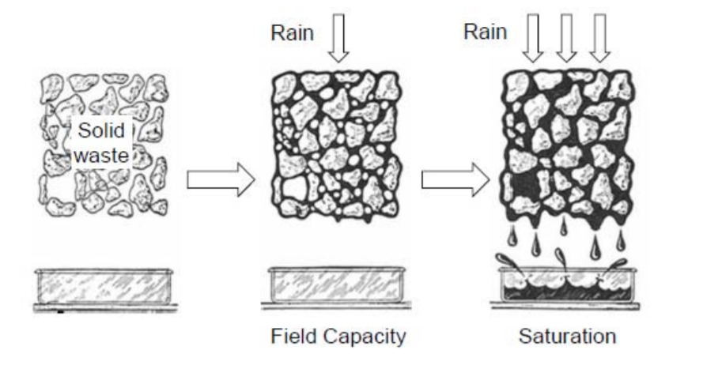
Physical Properties of MSW
2. Moisture content
Useful for estimating heat content, land sizing, transport requirements
Expressed either as % dry wt. or % wet wt.
M = [(wet wt. – dry wt) / wet. wt.] x 100
3. Particle size distribution
Required for improving rate of chemical reaction; compaction, etc
4. Field Capacity
Defined as total amount of moisture retained by mixed solids against force of gravity
Excess of field capacity results as leachate

Slide 23
Physical Properties of MSW
4. Field Capacity
Varies with degree of pressure applied to the waste and state of decomposition
The field capacity of the waste of un-compacted co-mingled waste from residential and commercial sources range from 50 – 60 %
FC = 0.6 – 0.55(W/[4500 + W])
FC – percent dry wt. of waste
W – Over burden of weight calculated at mid-height of the waste in lift (kg)
5. Hydraulic Conductivity
Defines movement of liquids (especially leachate) and gases in landfill
Dense materials such as sludges tend to resist rainfall infiltration and promote runoff
In contrast, paper and yard waste facilitate void space and less resistance to rainfall water
Loose samples of MSW have HC of 15 x 10⁻⁵ m/s (approx.)
Dense baled waste has 7 x 10⁻⁵ m/s (approx.)

Slide 24
Solid Waste Management – Source Videos
https://www.youtube.com/watch?v=-MS8vfcTmSM:
Video – Solid Waste Management of Indore City
https://www.youtube.com/watch?v=VtaFjkkozvE:
Video – Decentralized Biowaste Management of Indore City
https://www.smartcityindore.org/video-gallery/:
Video - Bioremediation of Solid Waste
https://www.smartcityindore.org/solid-waste/:
Write-up
https://www.tribuneindia.com/news/transforming-trash-into-treasure-the-swedish-way-54391:
Write-up

Slide 25
In the next……
You will be introduced to
  Energy recovery from municipal solid waste through Incineration, Pyrolysis and Gasification

